Slide 1
Reinforcement Learning on Robotics
Stanford Pre-Collegiate Summer Institutes
(Fake) CS 123 Artificial Intelligence on Robotics
Final Project Presentation
Hanke Chen & https://github.kokecacao.me Lecture 0 - 0 3 Aug 2018

Slide 2
Schedule
Problem (okay)
Approach (boring)
Implementation (boring)
Demo (fun)
Ads…
Hanke Chen & https://github.kokecacao.me Lecture 0 - 0 3 Aug 2018

Slide 3
Problem
Find the best path
Should not be dangerous
Should be efficient path (low energy cost)
Configuration easy to change
Let robot plan the path given the condition
Perform well in all environment
In rocky environment, choose to avoid rocks based on the risk it should take
No problem with local minimum issue
Slow in training, Fast in testing
Take account of “slippery environment”
Have more fun (as I said, I enjoy learning)
Hanke Chen & https://github.kokecacao.me Lecture 0 - 0 3 Aug 2018

Slide 4
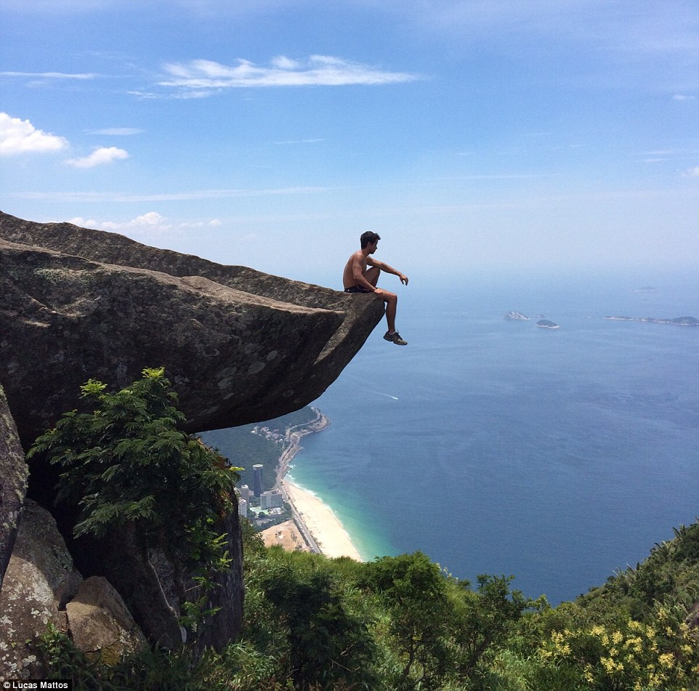
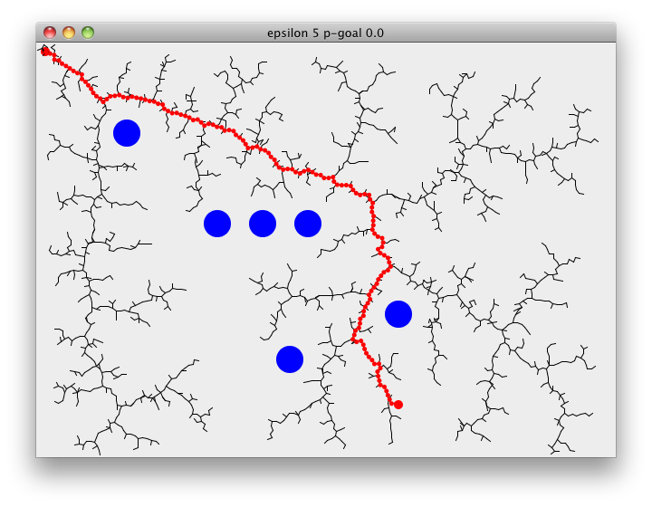
Problem – Environment
Find the best path
Should not be dangerous
Should be efficient path (low energy cost)
Not this again!
（╯#-皿-)╯~~╧═╧
Your hamster Nodes are not evenly distributed and have to turn a lot!
It cannot ‘refine’ the path.
https://nakkaya.com/images/post/rrt-5-0.png
https://i.dailymail.co.uk/i/pix/2016/04/20/08/3354F34800000578-3546181-Some_visitors_like_Lucas_Mattos_have_been_getting_dangerously_cl-m-2_1461138294235.jpg
Hanke Chen & https://github.kokecacao.me Lecture 0 - 0 3 Aug 2018

Slide 5
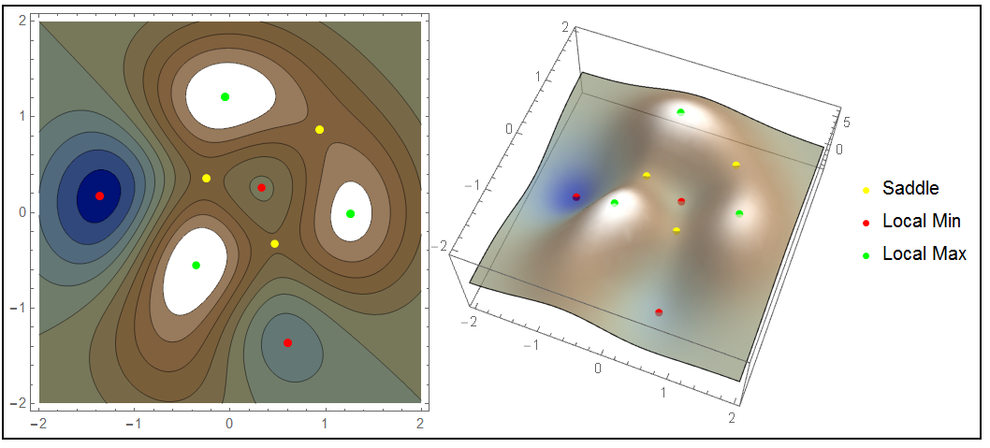
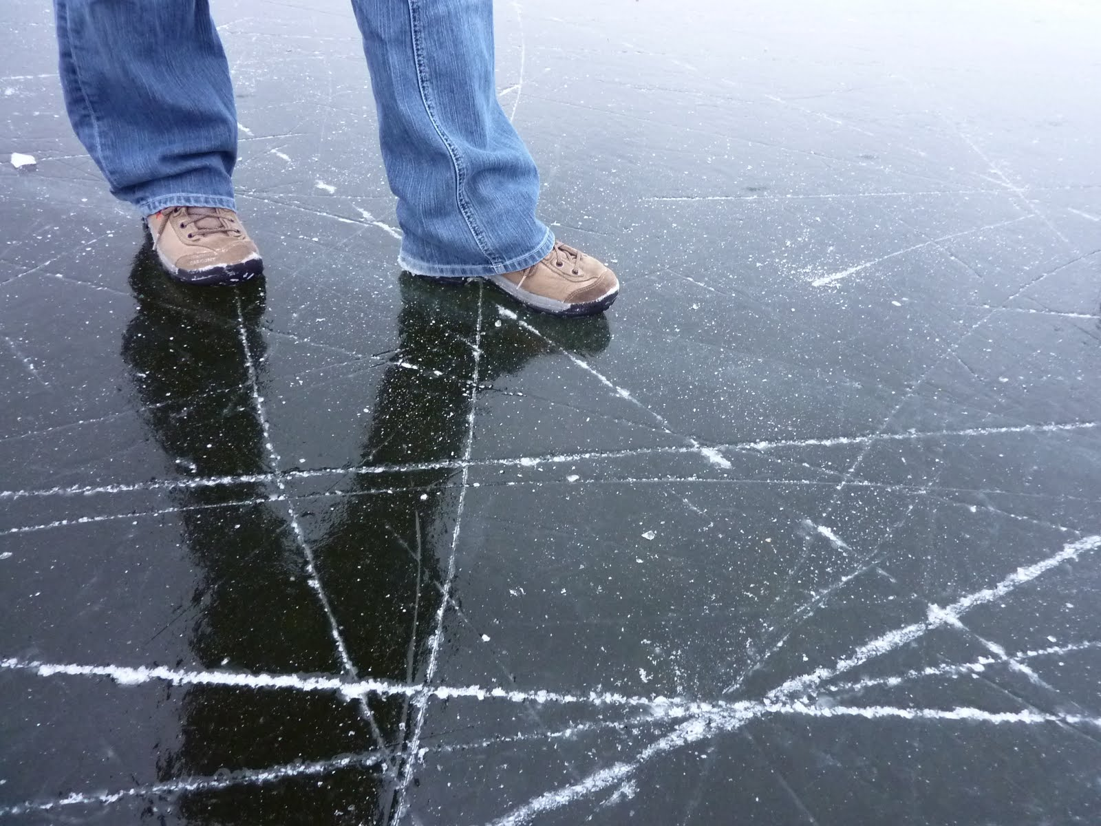
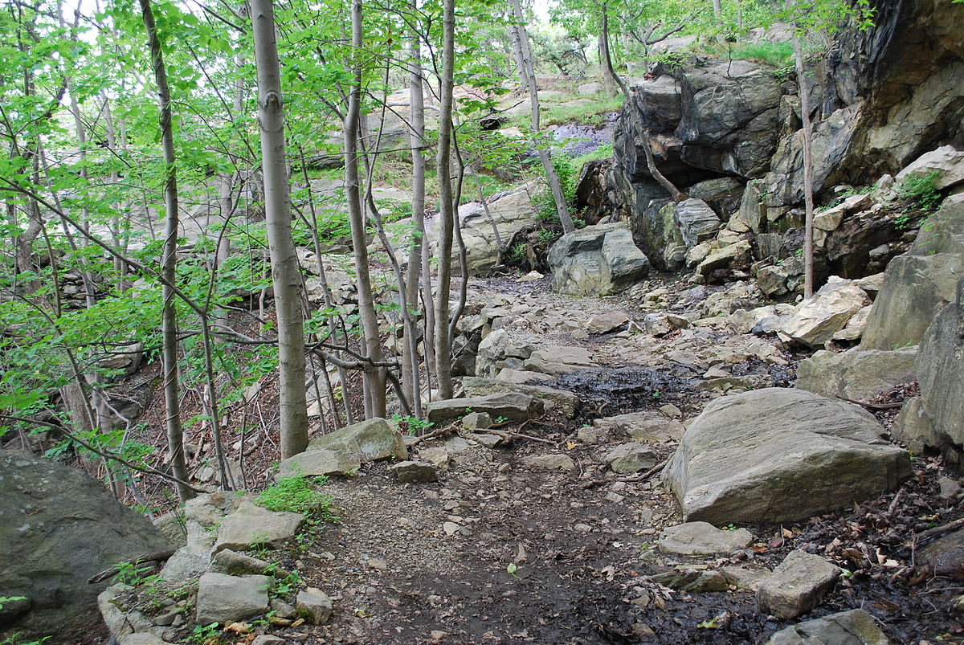
Problem - Environment
Source: https://i.stack.imgur.com/SbPz0.png
Perform well in all environment
In rocky environment, choose to avoid rocks based on the risk it should take
No problem with local minimum issue
Slow in training, Fast in testing
Take account of “slippery environment”
http://1.bp.blogspot.com/_QZdyr63Hz00/Sw63r4lNZMI/AAAAAAAAAGA/F9CniSFNMnQ/s1600/P1000582.JPG
https://upload.wikimedia.org/wikipedia/commons/thumb/3/37/Flirtation_Walk%2C_West_Point_NY_June_2010.JPG/1200px-Flirtation_Walk%2C_West_Point_NY_June_2010.JPG
Hanke Chen & https://github.kokecacao.me Lecture 0 - 0 3 Aug 2018

Slide 6
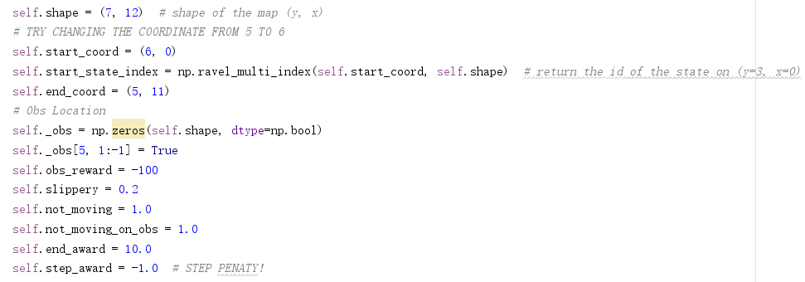
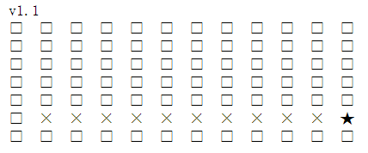
Problem
Configuration easy to change
Let robot plan the path given the condition
Have more fun
Hanke Chen & https://github.kokecacao.me Lecture 0 - 0 3 Aug 2018

Slide 7

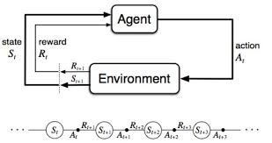
Approach
https://phz8.petinsurance.com/-/media/all-phz-images/2016-images-850/dogtraining850.jpg
Reinforcement Learning
Agent: States, Action, Policy, Rewards
Monte Carlo Method
Model: build -> evaluate -> improve
Temporal Difference Method
Genetic Algorithm
From Udacity Textbook
Hanke Chen & https://github.kokecacao.me Lecture 0 - 0 3 Aug 2018

Slide 8
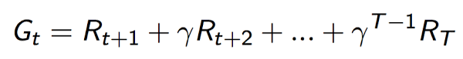
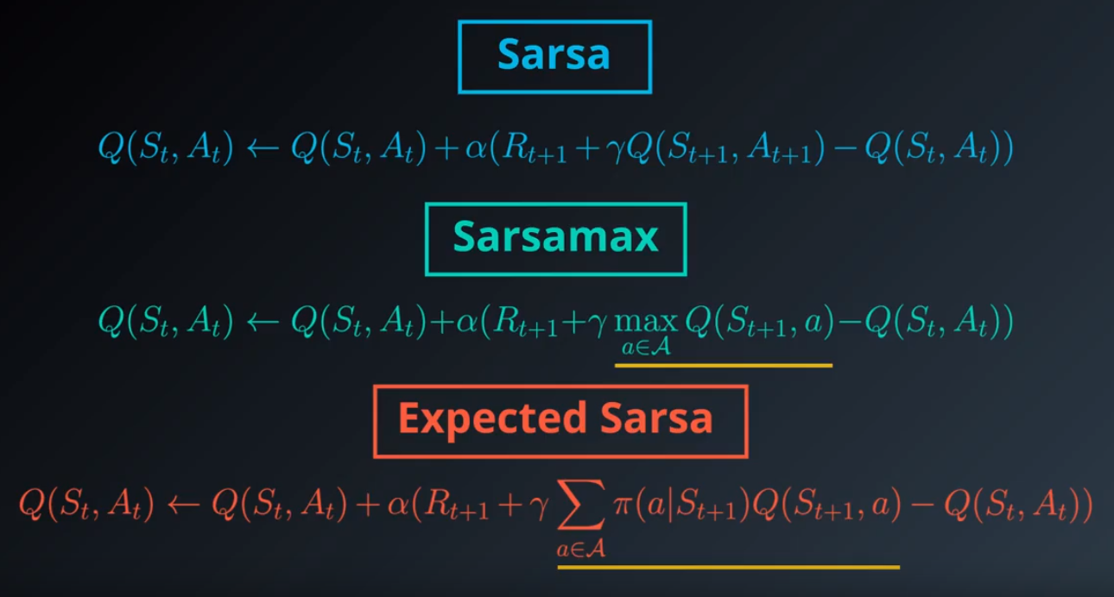
Approach
Reinforcement Learning
Agent: States, Action, Policy, Rewards
Iterative Method
Monte Carlo Method
Model: build -> evaluate -> improve
Temporal Difference Method
Genetic Algorithm
From Udacity RL Course
Hanke Chen & https://github.kokecacao.me Lecture 0 - 0 3 Aug 2018

Slide 9
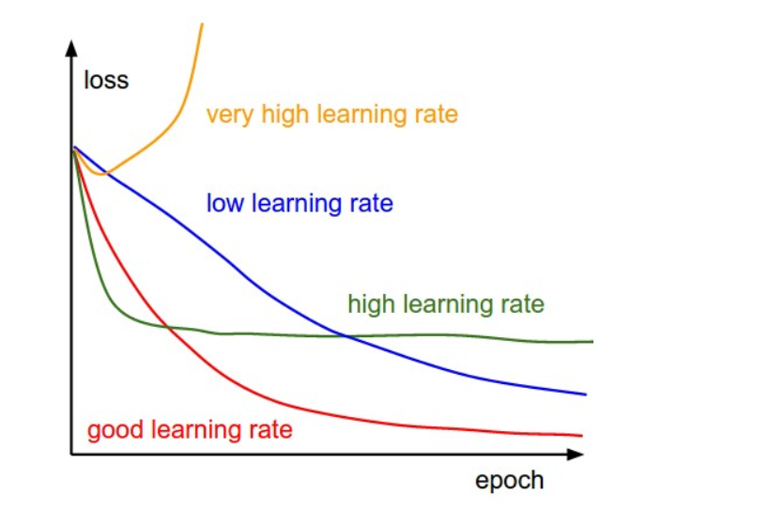
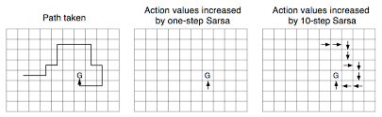
Approach
Reinforcement Learning
Agent: States, Action, Policy, Rewards
Iterative Method
Monte Carlo Method
Model: build -> evaluate -> improve
Temporal Difference Method
Genetic Algorithm
https://encrypted-tbn0.gstatic.com/images?q=tbn:ANd9GcS11rzP5gHy_I-Kc8hSMUL2Ixaxbf74F2P8FbyxC_bjvHRsAQ5F
Hanke Chen & https://github.kokecacao.me Lecture 0 - 0 3 Aug 2018

Slide 10

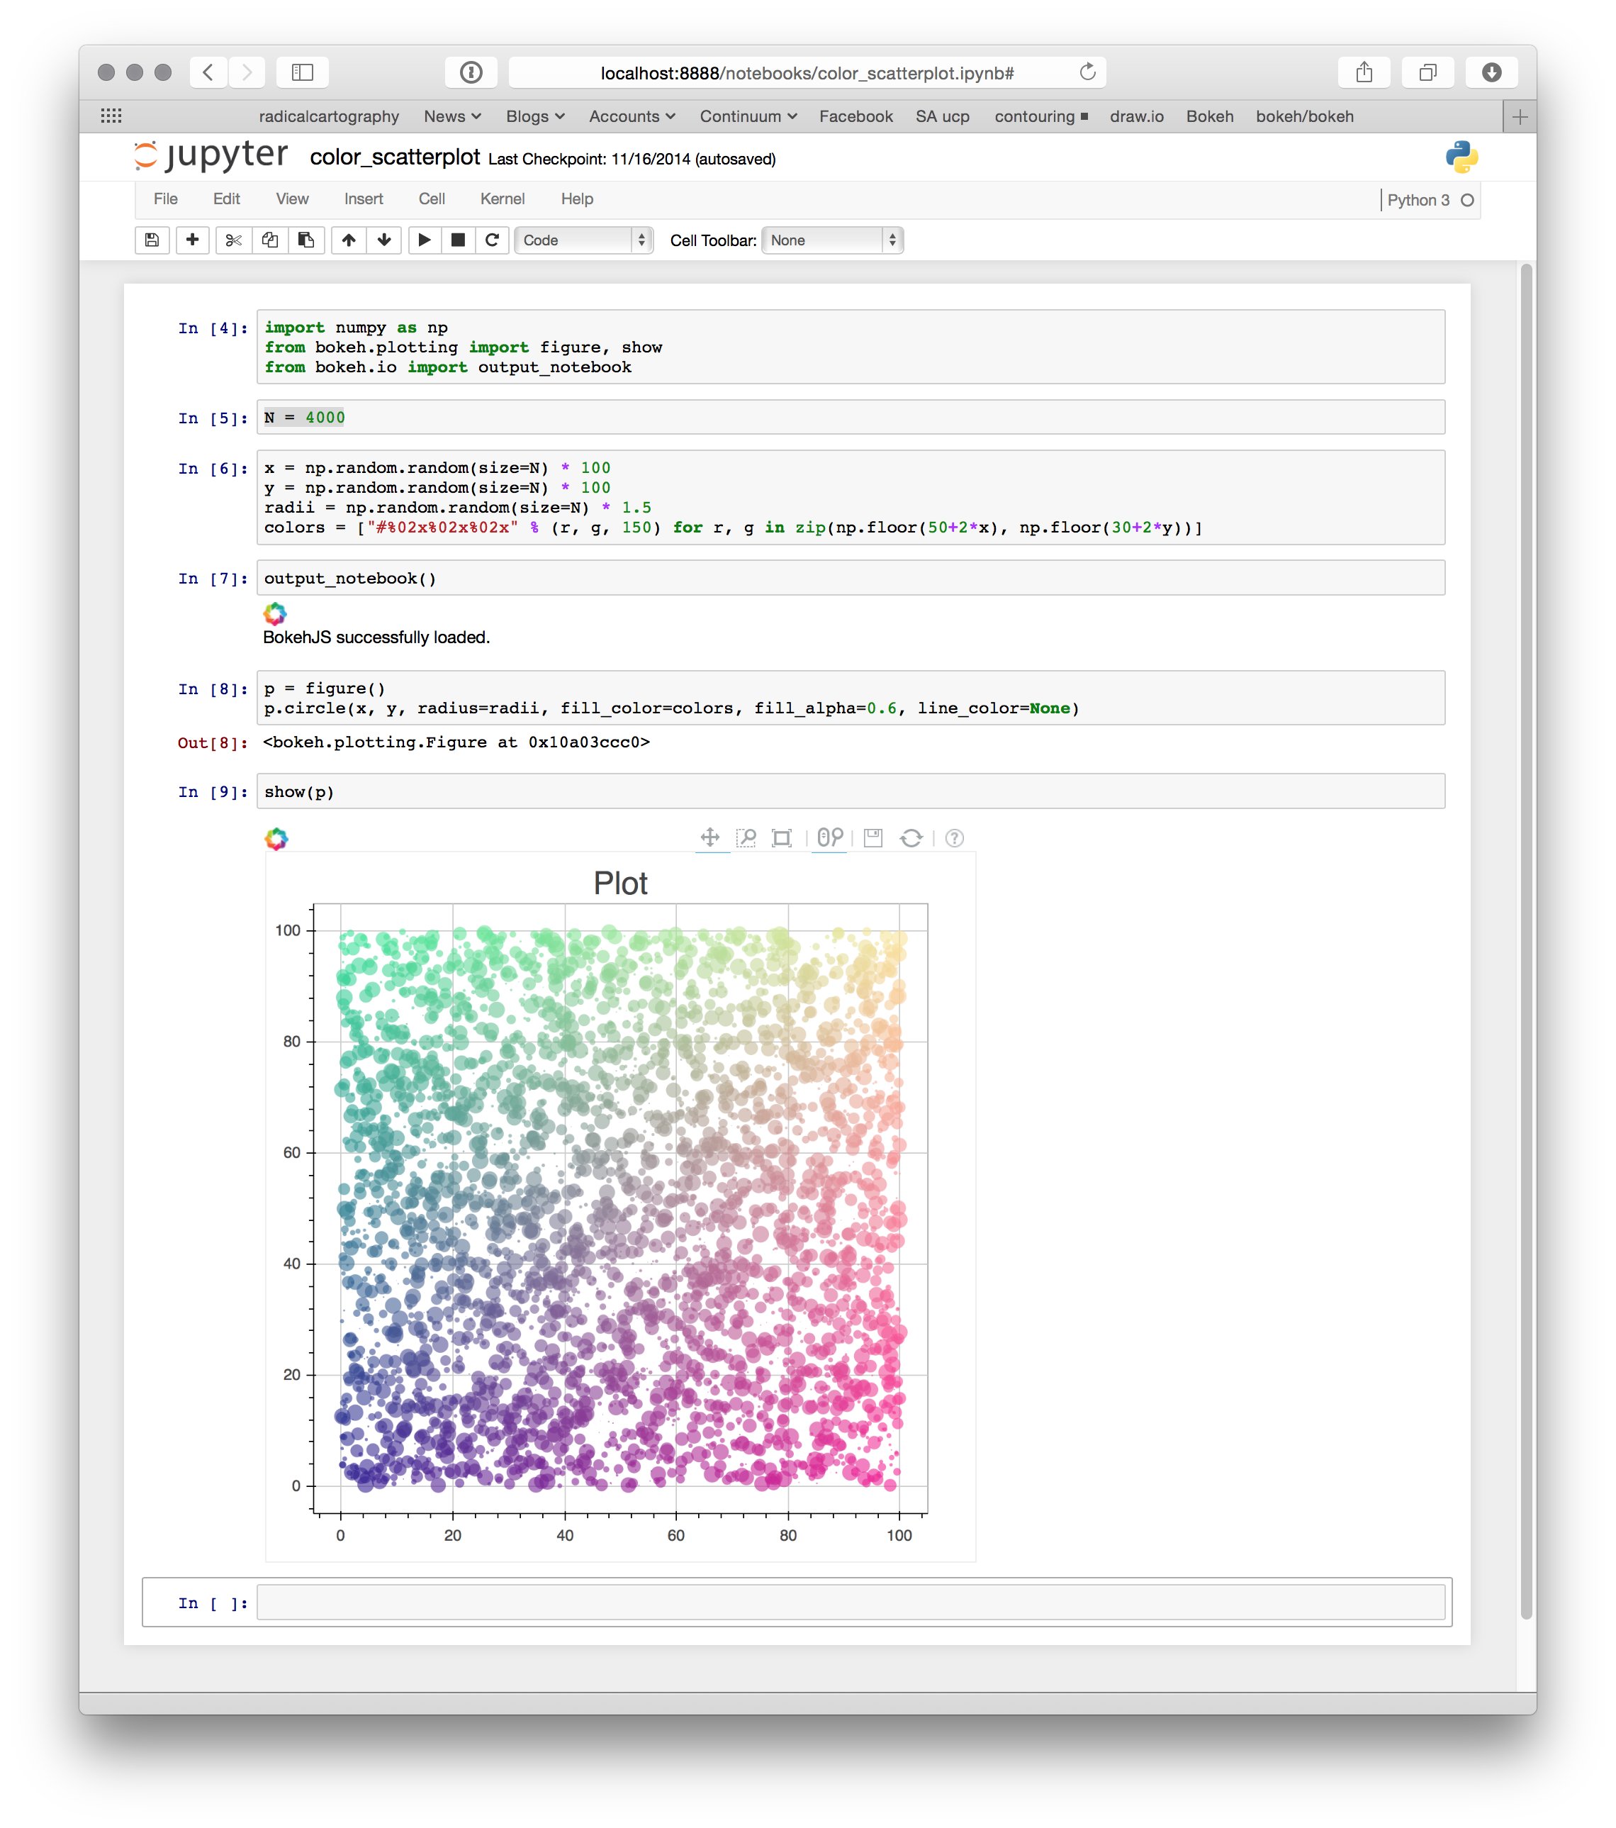
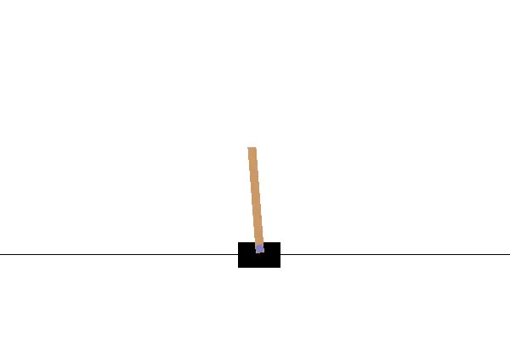
Implementation
Reinforcement Learning
Iterative Method
Epsilon Greedy Policy
OpenAI – Gym
Game Engine
Jupyter Notebook
Training Experiments
Hanke Chen & https://github.kokecacao.me Lecture 0 - 0 3 Aug 2018

Slide 11
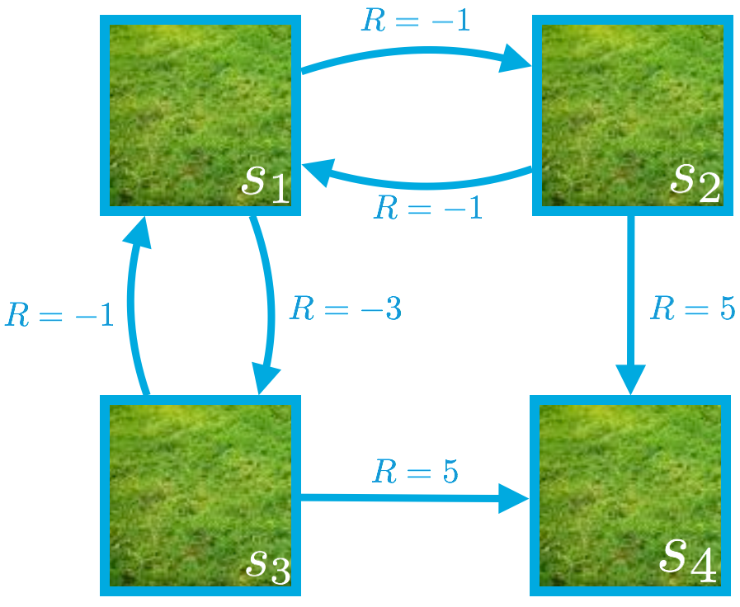
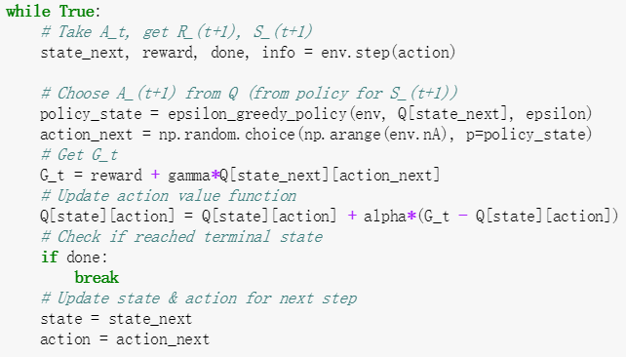
Implementation - Iterative Method
Picture from Udacity RL
Hanke Chen & https://github.kokecacao.me Lecture 0 - 0 3 Aug 2018

Slide 12

Implementation - Epsilon Greedy Policy
+1
+0
+1
+0
+1
+0
+100
+0
+100
+0
Picture from Udacity RL
Hanke Chen & https://github.kokecacao.me Lecture 0 - 0 3 Aug 2018

Slide 13
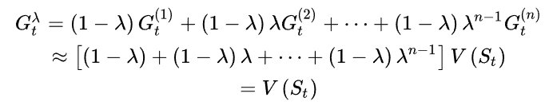
Implementation – Sarsa(0)
Picture from Udacity RL
Hanke Chen & https://github.kokecacao.me Lecture 0 - 0 3 Aug 2018

Slide 14
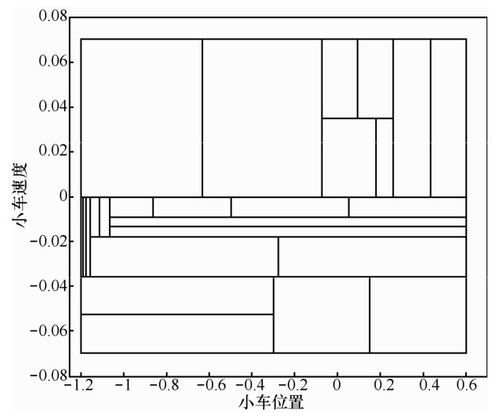
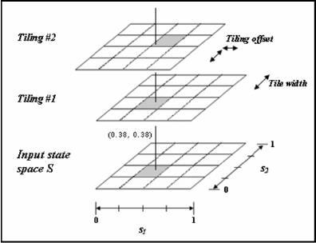
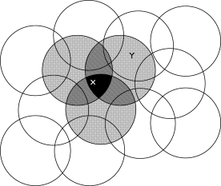
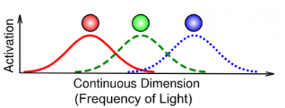
Future / Improvements
http://www.infocomm-journal.com/txxb/article/2015/1000-436x/1000-436x-36-2-00186/img_224.jpg
More interesting Hamster Game
Multiple Hamster Playing Football
Hamster Flappy Bird
Discretize the space
Tile Coding / Adaptive Tile Coding /
Function Discretization or Deep-Q learning
http://incompleteideas.net
http://grey.colorado.edu
https://www.researchgate.net/profile/Daniel_Borrajo/publication/228539409/figure/fig4/AS:301992128860163@1449011942320/Tile-coding.png
Hanke Chen & https://github.kokecacao.me Lecture 0 - 0 3 Aug 2018

Slide 15
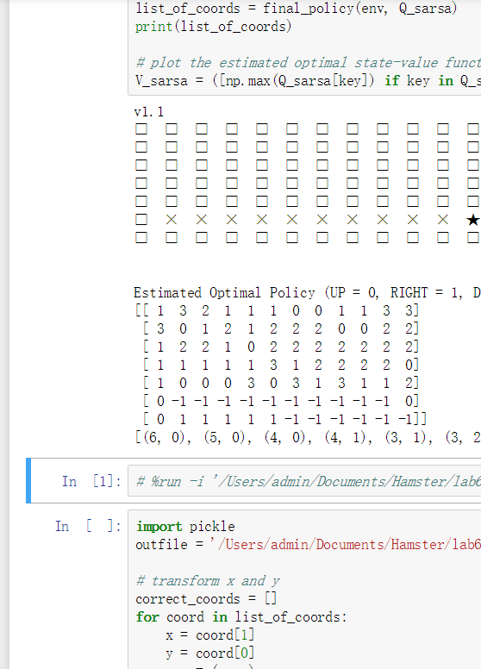
Live-Demo
Hanke Chen & https://github.kokecacao.me Lecture 0 - 0 3 Aug 2018

Slide 16
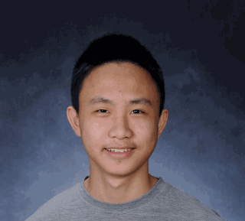


Quick Ads (Because it is the last day here)
This presentation is sponsored by KokiCraft Server, SSFS Robotics Club (BeestBot), and myself…
Hanke Chen & https://github.kokecacao.me Lecture 0 - 0 3 Aug 2018

Slide 17
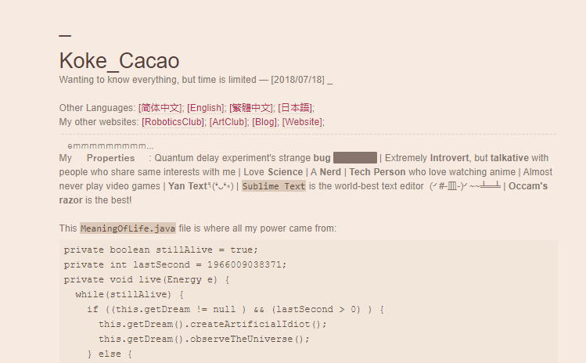

Quick Ads (Because it is the last day here)
If you love this presentation, please clap and don’t forget to check out my websites. [www.kokecacao.me, ssfs.club] (Github, Wechat, Instagram provided…)
Hanke Chen & https://github.kokecacao.me Lecture 0 - 0 3 Aug 2018

